Slide 1
Project deliverable 1
New York Cartel
Alexis FAURE Okba ABDELMOUMENE Maroiane ISOUAL

Slide 2
Content
Introduction
01. Problem 1
02. Problem 2
03. Problem 3
Conclusion

Slide 3

Introduction

Slide 4
Problem 1
Assumptions
several zones available (5)
"all zone" tickets
recharge card
tickets expire in 2h once used
accepts credit card and cash
Price depends on the number of zone
user can choose the language of the TVM (French, English)
audio description available
stations with access to people with motricity issues are specified

Slide 5
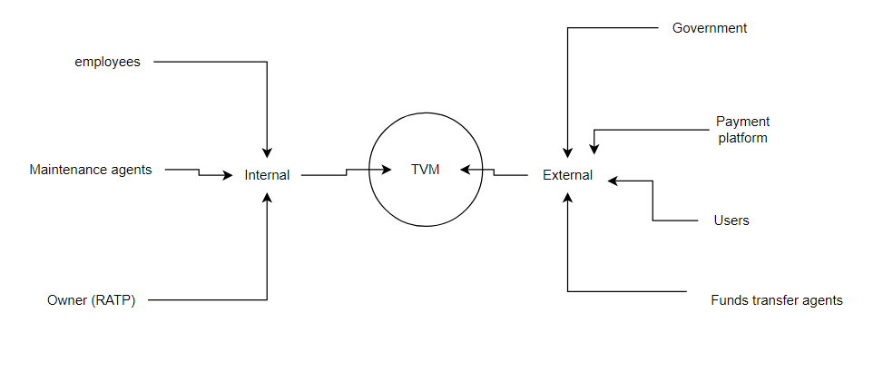
Problem 2
Stakeholder diagram

Slide 6
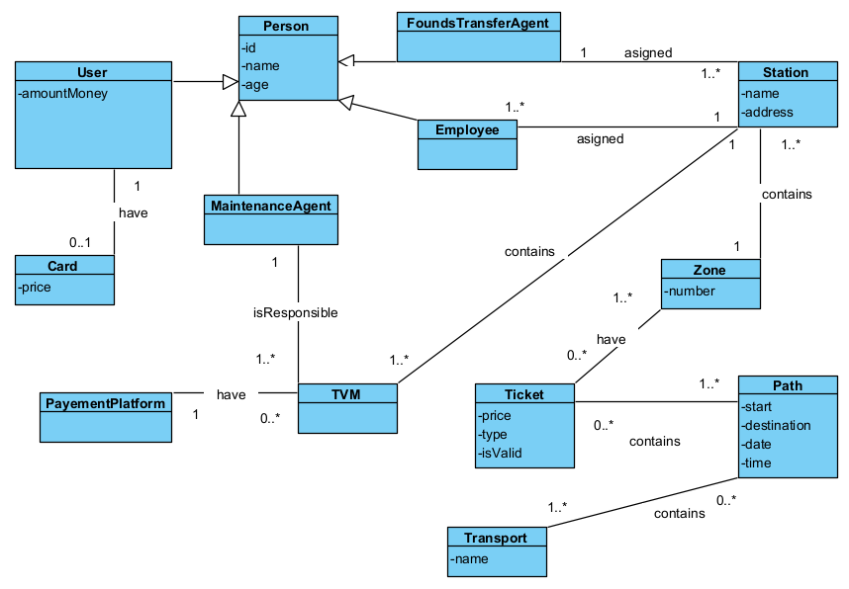
Problem 3
UML Diagram

Slide 7

Conclusion

